Slide 1

Multilevel Modeling in R
Workshop/Tutorial by Carla N. Martinez-Perez, M.Sc.

Slide 2
Introduction and Overview
Foundations of Multilevel Modeling (20 mins)
Comparing MLM to Traditional Methods (20 mins)
Setting up your data for R (20 mins)
Hands-On Experience: Running Simple MLM in R (30-45 mins)
Interpreting and Visualizing MLMs (15 mins)
Practice (on your own!) with feedback (1 hour, or as needed)
Additional Resources
This tutorial is intended to take 3-4 hours.

Slide 3
Introduction and Overview
Materials needed:
Laptop with R and Rstudio installed
Printed handouts or digital PDFs of slides and
Sample data and R code: https://github.com/cnmarper/MLM-Workshop
Example datasets (CSV format) for on-your-own practice
Notes:
Brief discussion on participants’ familiarity with statistics and R

Slide 4
Notes:
Brief discussion on participants’ familiarity with statistics and R, and specifically to MLM

Slide 5
Foundations of MLM
Just a little theory before we begin …

Slide 6
Multilevel data = non-independent data (clustering)
Ex.
Bunch of students have the same teacher
Subjects measured multiple times
When we treat clustered data as unclustered = ↑ Type I error
Smith
Rivera
Rowe
S1
S2
S3
S4
S5
S6
S7
S8
S9
Subject 1
Subject 2
Subject 3
T1
T2
T3
T1
T2
T3
T1
T2
T3

Slide 7
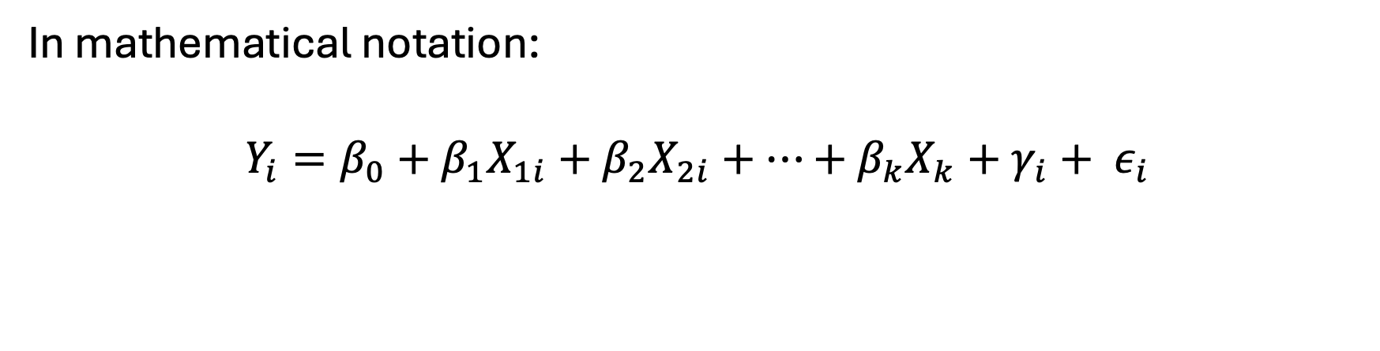
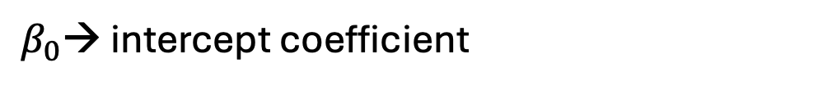
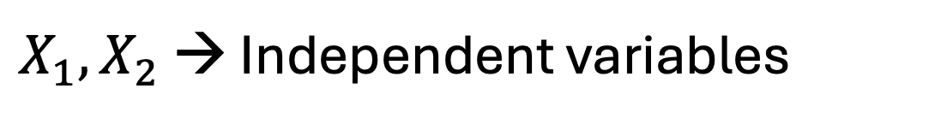
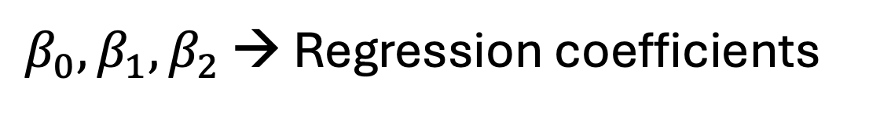
In mathematical notation:
$$Y_{i}=β_{0}+β_{1}X_{1i}+β_{2}X_{2i}+…+β_{k}X_{k}+γ_{i}+ ε_{i}$$
Linear predictor
Error
Outcome
Random intercept
$β_{0}, β_{1}{, β}_{2}$ → Regression coefficients
$X_{1}{, X}_{2}$ → Independent variables
$β_{0}$→ intercept coefficient
$β_{1 }β_{2 }$→ association of the IVs (X₁ and X₂) with the outcome Y
Notes:
Error OR residuals - - refers to the random variation of participants’ rating around the group mean
>> the error that would be associated with predicting any given participants’ outcome based on just the linear predictor
The intercept is what we also understand as the point of comparison

Slide 8
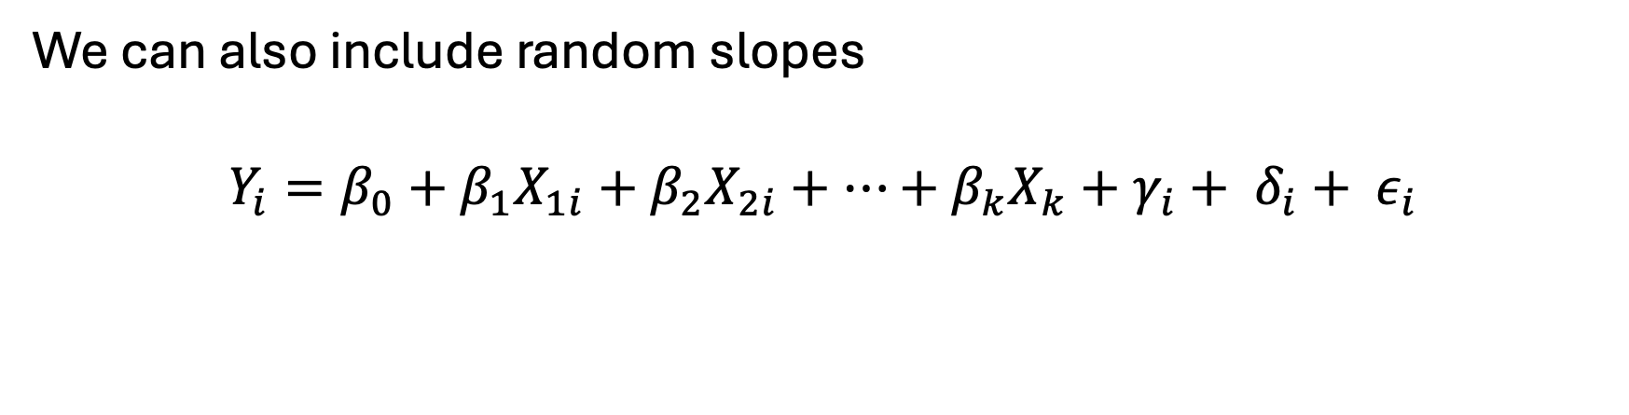
We can also include random slopes
$$Y_{i}=β_{0}+β_{1}X_{1i}+β_{2}X_{2i}+…+β_{k}X_{k}+γ_{i}+ δ_{i}+ ε_{i}$$
Allow for the possibility that the relationship between a predictor variable and an outcome variable can vary across different groups or units
Gives us a more flexible and realistic model of the data
Notes:
Error OR residuals - - refers to the random variation of participants’ rating around the group mean
>> the error that would be associated with predicting any given participants’ outcome based on just the linear predictor
The intercept is what we also understand as the point of comparison

Slide 9
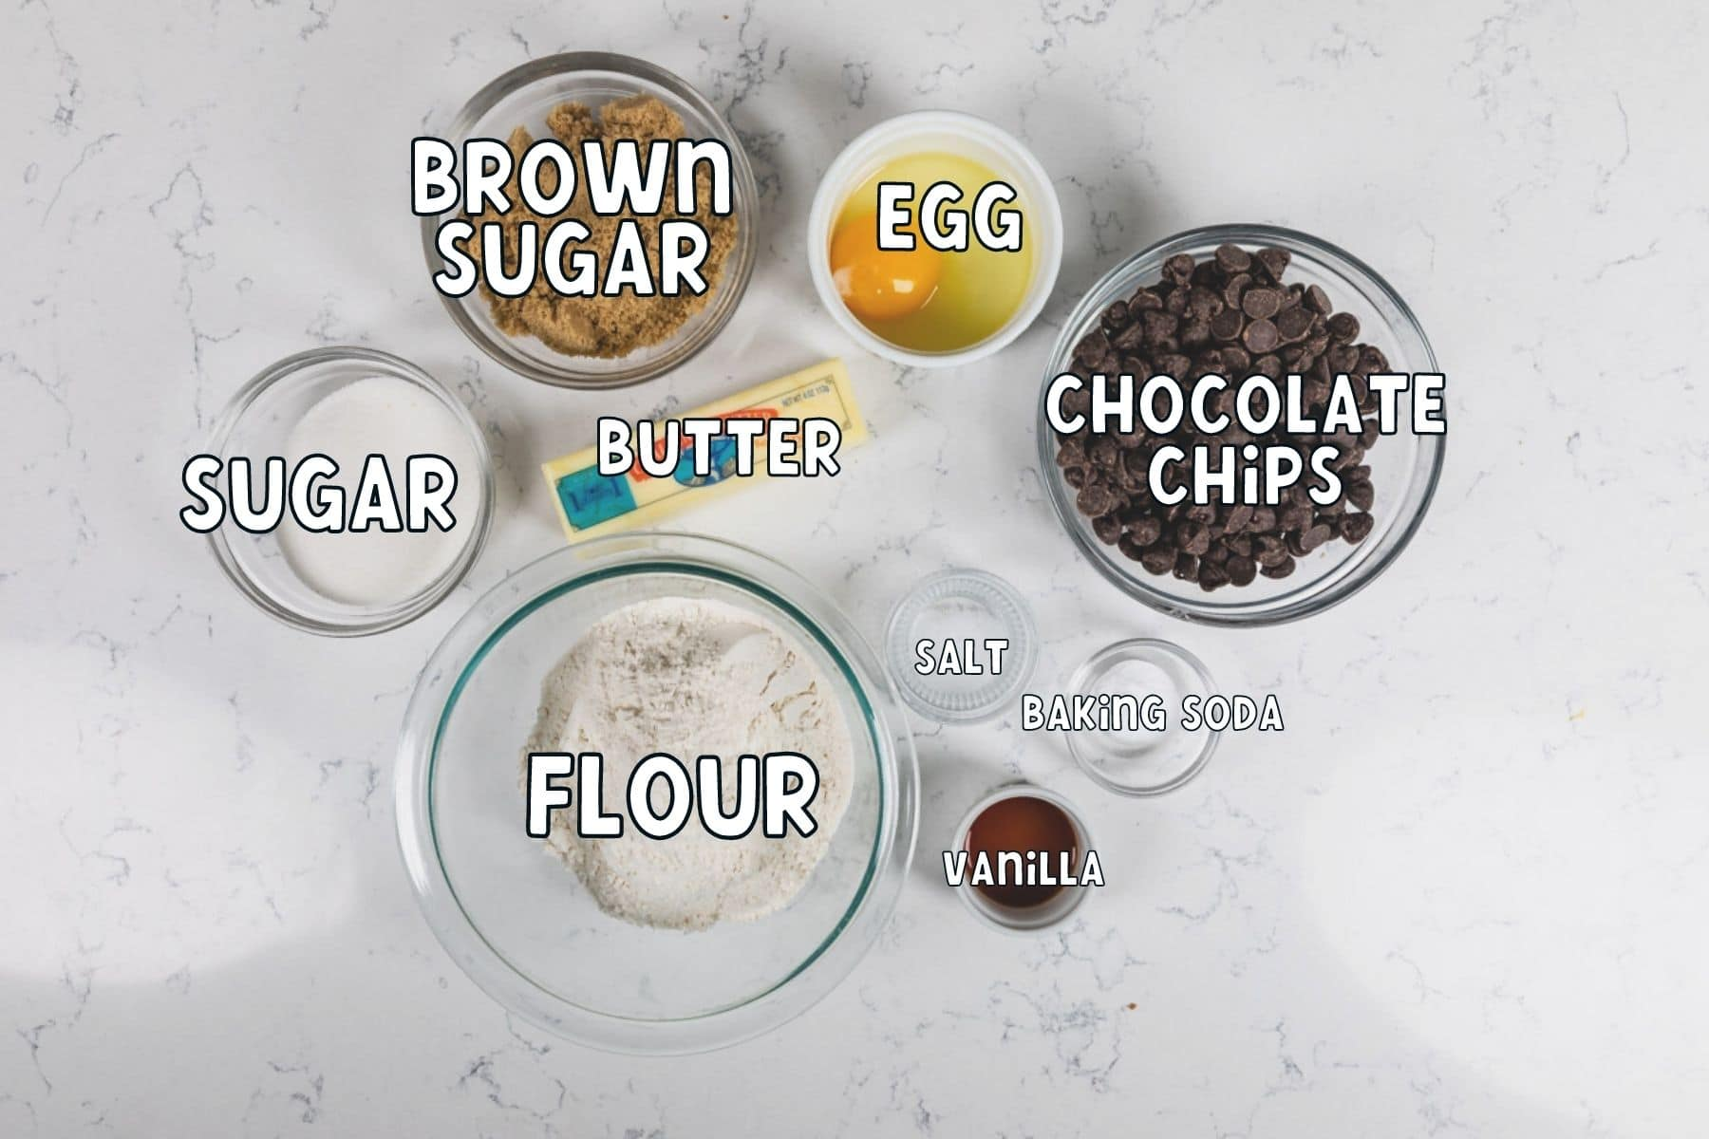
Fixed vs. Random Effects
Fixed effects = main predictors
Constant across individuals or groups and represent the average effects of a predictor variable
Example:
In a cookie recipe, the ingredients needed for it are consistent, measurable influences → fixed effects

Slide 10

Fixed vs. Random Effects
Random effects = the variance that describes how much an effect differs across clusters
Groups may have different baseline levels or slopes that are not fixed but vary randomly
Example: Each kitchen in which a cookie is baked, the oven might have varying temperatura and heating differences
Notes:
Random effects capture the variability due to different groups or contexts, acknowledging that these effects vary randomly and are not consistent across all situations.
These ovens represent random effects which will have varying influences on the outcome variable

Slide 11
MLM Assumptions
Model Specification is correct (based on theory)
Start with a null model to check for clustering
Run your “core” model
Run all posible models
Compare models based on AIC

Slide 12
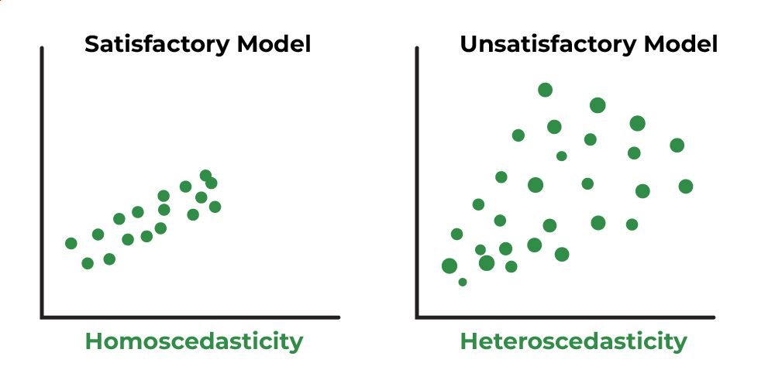
MLM Assumptions
2. Functional form is correct (e.g., linearity)

Slide 13
MLM Assumptions
3. Residuals:
A. Are normally distributed
B. Are independent (from predictors)
C. Have constant variance
Histograms and Q-Q plots for normality
Correlation test for Independence
Notes:
kurtosis test

Slide 14
Comparing MLM to Traditional Methods

Slide 15
T-test vs. MLM
Primarily suited for simple experimental designs with two groups (e.g., control vs. treatment)
T-test compares the means between two groups
Each data point is independent of the other
Example: Mean blood pressure between two groups → each individual measurement is unrelated to others
Assumes single source of variance (e.g., within-group variance)
Generalizability is limited

Slide 16
ANOVAs vs. MLM
Test for differences in means across multiple groups/conditions
Assess whether the variance between groups is greater than within groups
Requires balanced designs (e.g., equal n across groups)
Assumes sphericity (i.e., the variance of the difference between the groups is equal)

Slide 17
Setting up your data for R

Slide 18
Useful Resources:
R for ABSOLUTE beginners (15 minutes)
R for data analysis (1 hour) – includes t-tests, ANOVA, chi-squared tests, and linear regressions

Slide 19
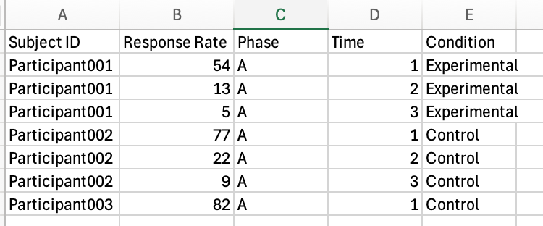
Setting up your data
R prefers it when the data is set as long form
Save your spreadsheet as a CSV file
Notes:
Show the Data_Long file

Slide 20
Hands-On Experience: Running Simple MLM in R
Open RStudio and download the datafile “Data_wide.csv”

Slide 21
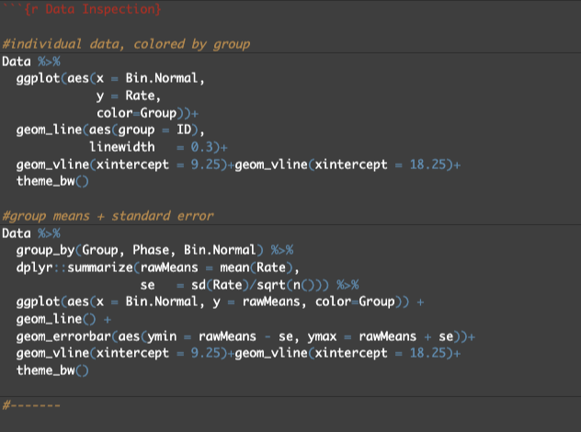
Visually inspect your data
Use ‘ggplot’ to view the data at both the individual level and groups
Double-check that the plots resemble the same trends observed by other charting programs

Slide 22
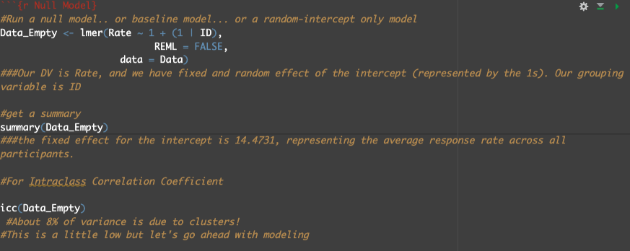
Run a Null Model
Also known as a baseline model or a random-intercept only model
What is your depedent variable?
What is your grouping variable?

Slide 23
Intraclass Correlation Coefficient
The ICC tells you what proportion of the total variance in the model is due to “clusters.” In other words, what variance is due to differences between groups.
Clusters could be individuals (like in our case, because we have a cluster of measurements — i.e., response rates — coming from individual participants), or they could be students within the same classroom, employees within supervisors, etc.
The ICC should be at least .05 (5%) or so (but there’s no fixed rule here) to justify the use of MLM

Slide 24
Models to Test
This depends on theory. Specifically, understanding which variables you are interested in evaluating that would help you explain the DV
Model No. | Fixed Effects | Random Effects
0 | 1 | (1 | id)
1 | Phase | (1 | id)
2 | Group + Phase | (1 | id)
3 | Group * Phase | (1 | id)
4 | Bin | (1 | id)
5 | Bin + Group | (1 | id)
6 | Bin * Group | (1 | id)
7 | Bin*Phase*Group | (1 | id)
Model No. | Fixed Effects | Random Effects
8 | 1 | (Bin | id)
9 | Phase | (Bin | id)
10 | Group + Phase | (Bin | id)
11 | Group * Phase | (Bin | id)
12 | Bin | (Bin | id)
13 | Bin + Group | (Bin | id)
14 | Bin * Group | (Bin | id)
15 | Bin*Phase*Group | (Bin | id)
Model No. | Fixed Effects | Random Effects
16 | 1 | (Bin + Phase | id)
17 | Phase | (Bin + Phase | id)
18 | Group + Phase | (Bin + Phase | id)
19 | Group * Phase | (Bin + Phase | id)
20 | Bin | (Bin + Phase | id)
21 | Bin + Group | (Bin + Phase | id)
22 | Bin * Group | (Bin + Phase | id)
23 | Bin*Phase*Group | (Bin + Phase | id)
You can evaluate as many models as your heart desires!

Slide 25
Fixed-Effects Structures
The “*” in Bin * Phase * Group indicates that we want to account for fixed effects of Bin, Phase, Group, and all possible interactions among Bin, Phase, and Group (i.e., Bin x Phase, Bin x Group, Group x Phase, and Bin x Group x Phase).
Including the Bin x Phase interaction allows us to examine whether there were different trends in responding across bins within each phase.
We include a Bin x Group interaction to examine whether changes in responding across bins differs as a function of Group – whether response rates were higher overall in one group versus another, etc.

Slide 26
Fixed-Effects Structures (cont’d)
The addition of a Group x Phase interaction allows us to examine between-group differences in sensitivity to reinforcement and extinction contingencies in Phases 1 and 2.
Finally, including the three-way interaction between Bin, Phase, and Group allows us to simultaneously test (1) differences in overall responding between phases, (2) differences in overall responding between groups, and (3) whether changes in responding within each phase were dependent on Group – whether responding was more sensitive to a contingency in one group versus another.

Slide 27
Random-Effects Structures
The initial random intercept of ID allows for overall levels of responding to vary across individual participants
The best random-effects structure is evaluated here by comparing the initial model with all fixed effects (and random intercept of Participant only) to more complex models (up to two simultaneous random slope effects).
The random-slope effects that we’re evaluating are (1) Bin, which allows for participant-level differences in changes in responding across 30-s bins and (2) Bin + Phase, which allows for what is described in (1), and also for participant-level differences in changes in responding across experimental conditions (i.e., phases).

Slide 28
Compare models based on AIC
Akaike’s Information Criterion (AIC) is a measure of goodness of fit
We can test improvements in model quality between the different random-effects structures
The model with the lowest AIC is considered the “best” model

Slide 29
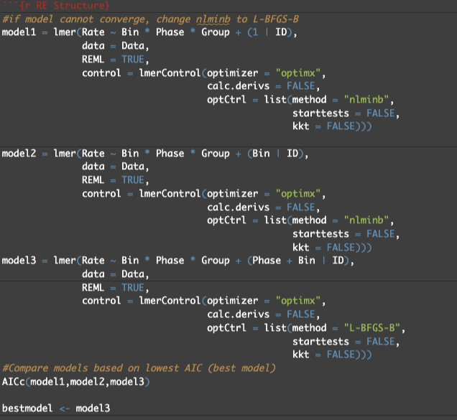
Define your model
Define the data
Add information related to MLM for
optimization (controls)
REML= Restricted Maximum Likelihood.
Helps create unbiased estimate of variance and
covariance parameters (thus, set to TRUE)
When using REML, there is a penalty applied to
the degrees of freedom when estimating the
variance components
Calc.dervis – for nonlinear solution
optCtrl – related to optimizers needed so
the model converges
Feel free to use as is but run ‘?lmerControl’ for
more information

Slide 30
Visualizing and Interpreting MLMs

Slide 31
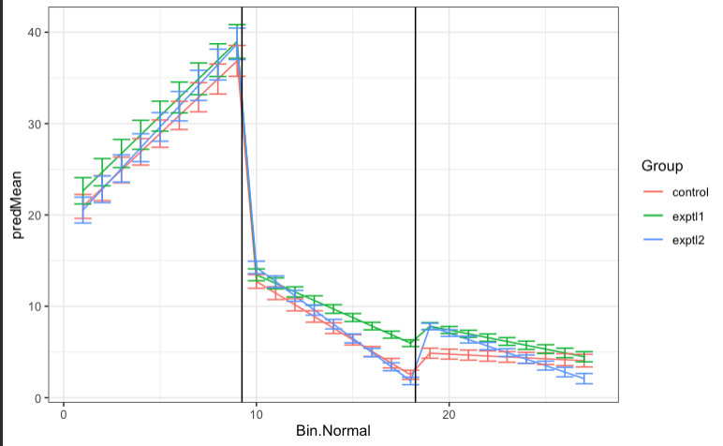
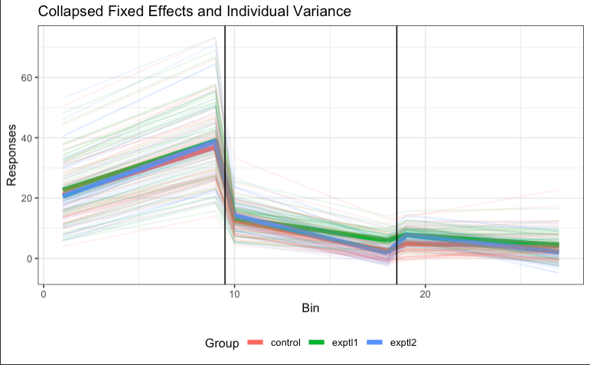
Model predictions
Visualize the model against the observed data.
Does the model describe the data well?

Slide 32
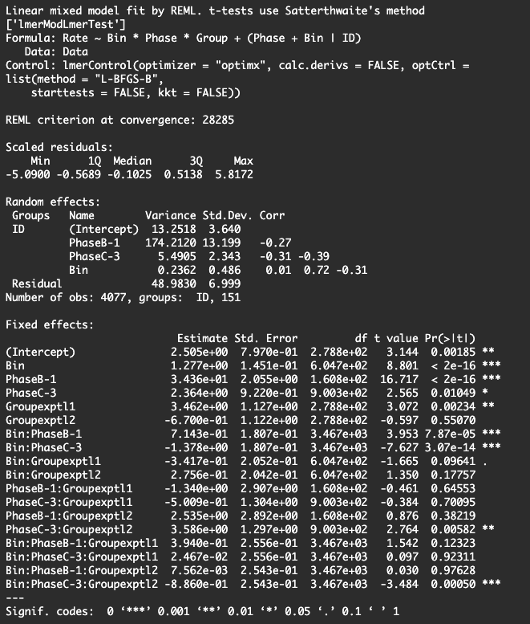
You get this from the ”summary(bestmodel)” line
Walk through each fixed-effects coefficient and understand how it related to your outcome variable.
Intercept (Phase 2, Group Control)
This estimate reflects that the logs-odd of a response for the average participant in the control condition and in Phase 2 is 2.5.
Phase 1 and 3
This estimate reflects an increase in the log-odds of a response for participants in the control group in Phase 1, and there’s a slight decrease in responding in Phase 3. Both compared to Phase 2.
This makes sense: we see greater responding in Phase 1 vs. 2, and somewhat less responding in Phase 3 vs. 2

Slide 33
Group Experimental 1
Being in the Expt’l group 1 is associated with an increase in responding compared to the Control group
Bin * Phase (1) and (3)
The effect of Bin on responding is different in Phase 1 vs. 2, and 3 vs. 2.
Phase (3) * Group (Expt’l 2)
The effect of Phase 3 on responding was different in Group Experimental 2 compared to the Control group and Phase 2. In this case, we interpret is as “the change of going from Phase 2 to Phase 3 was resulted in differences in the changes in responding for Group Experimental 2 compared to Control”
Bin * Phase (3) * Group (Expt’l 2)
The combined effect of Bin and Phase (3) on responding is different in Group Expt’l 2 compared Control group and Phase 2. Thus, over time, responding decreased faster for the control group compared to the experimental group
Notes:
Go to R code and show ES and post hocs

Slide 34
What does the “1” mean in ”Rate ~ 1 + (1 | ID)”? The first 1 represents that we are evaluating the model at the overall mean of Rate
(1|ID) means we want a random intercept at each level of ID (i.e., we want a random intercept for each participant)

Slide 35
Practice
Grab some of your own data (or create some!), the template code, and get started

Slide 36
Great! You now know how to do MLM in R!

Slide 37
Additional Resources (Open-sourced!)
Frank, M. C., Braginsky, M., Cachia, J., Coles, N., Hardwicke, T. E., Hawkins, R. D., Mathur, M. B., & Williams, R., (2024). Experimentology: An Open Science Approach to Experimental Psychology Methods. MIT Press. https://experimentology.io/
Shaw, M., & Flake, J. K. (2022). Introduction to Multilevel Modeling. https://www.learn-mlms.com/index.html
MLM: A simple explanation (https://youtu.be/c_tYZxQLoDA?si=JT4sB-lITd-nJFkD)

Slide 38
But what if I have a binary outcome (e.g., yes/no), or a count outcome (e.g., # of responses)?????
Additional Resources

Slide 39
Generalized linear mixed-effects model
The concept is pretty much the same but instead us “glmer” function in R

Slide 40

For questions and/or comments: c.martinezperez@ufl.edu
Please rate how I did: Google Form or

